Slide 1

Machine Learning-Evaluation Metrics for Classification
Classification Evaluation metrics in Machine Learning-Accuracy, Confusion Matrix-related metrics and ROC curve
Dr. Manju Venugopalan
Asst professor (Sr. Gr)
Dept of CSE
Amrita School of Computing, Bengaluru

Slide 2
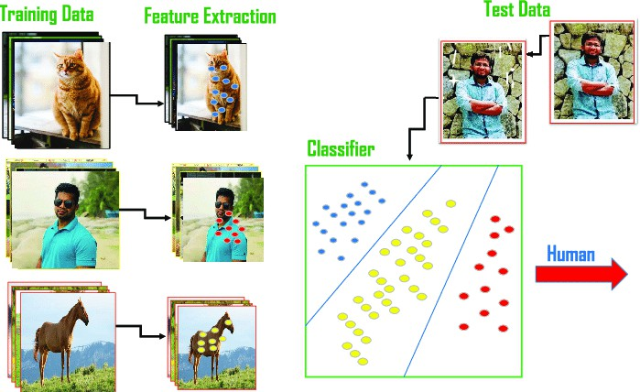
Classification Problem

Slide 3
No Free Lunch Theorem in ML
The "No Free Lunch" theorem in machine learning is named as such because
it conveys
the idea that there is no universally superior algorithm that performs better than all others
across all possible problem domains or datasets .
. In
other words, there is "no free lunch" when it comes to machine learning algorithms –
no
one-size-fits-all solution.
This concept was first formalized by David Wolpert in the late 1990s. The theorem essentially states that the performance of an algorithm on a particular problem or dataset depends on the characteristics of that problem or dataset, and there is no algorithm that is superior for all possible scenarios. In practical terms, it means that different machine learning algorithms may excel in different types of problems, and the choice of algorithm should be guided by the specific nature of the problem you are trying to solve.
The name "No Free Lunch" is a metaphorical way of emphasizing that there are no shortcuts or guarantees of superior performance without considering the specifics of the problem at hand. It's a reminder that in machine learning, you often have to make informed choices based on your understanding of the data and problem domain, and there is no universal algorithm that will always provide the best results.

Slide 4
Why do we Need Evaluation Metrics?
Evaluation metrics can help you assess your model’s performance, monitor your ML system in production, and control your model to fit your business needs.
Our goal is to create and select a model which gives high accuracy on out-of-sample data(unseen data/test data set).
It’s very crucial to use multiple evaluation metrics to evaluate your model because a model may perform well using one measurement from one evaluation metric while may perform poorly using another measurement from another evaluation metric.
If you choose the wrong metric to evaluate your models, you are likely to choose a poor model, or in the worst case, be misled about the expected performance of your model

Slide 5
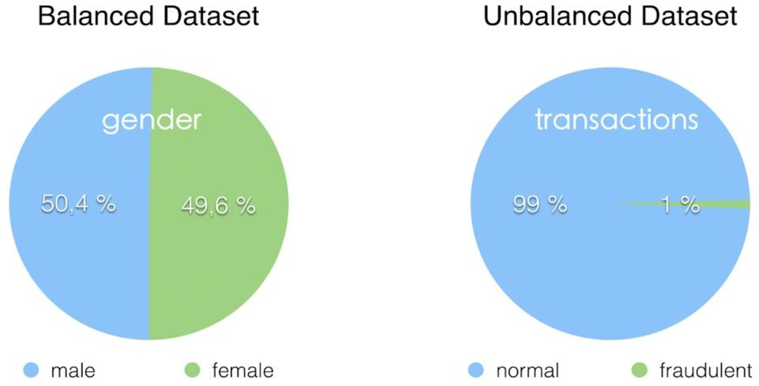
Classification Accuracy
The simplest metric for model evaluation is Accuracy. It is the ratio of the number of correct predictions to the total number of predictions made for a dataset.
Accuracy=
No of correct Predictions/ Total no of predictions
Accuracy is useful when the target class is well balanced but is not a good choice with unbalanced classes.
Accuracy gives us an overall picture of how much we can rely on our model’s
prediction.
This metric is blind to the difference between classes and types of errors. That’s why it is not good enough for imbalanced datasets.

Slide 6
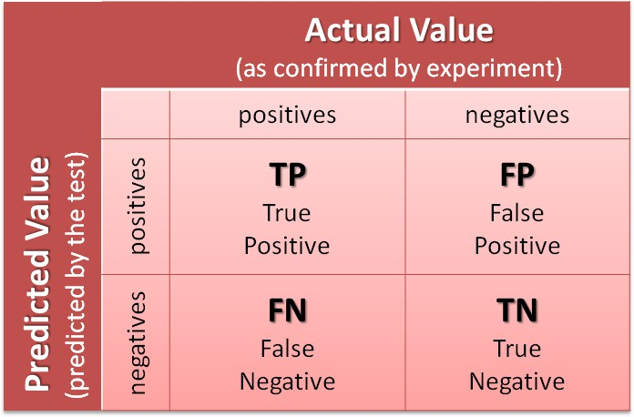
Confusion Matrix:
A confusion matrix or error matrix is a table that shows the number of correct and incorrect predictions made by the model compared with the actual classifications in the test set or what type of errors are being made.
This matrix describes the performance of a classification model on test data for which true values are known. It is a n*n matrix, where n is the number of classes. This matrix can be generated after making predictions on the test data.
Here, columns represent the count of actual classifications in the test data while rows represent the
count of predicted classifications made by the model.
Positive and Negatives refers to the prediction itself. True and False refers to the correctness of the prediction.

Slide 7
Confusion Matrix: Example
An example of a classification problem: predicting whether a person is having diabetes or not. A label to our target variable→ 1: A person is having diabetes | 0: A person is not having diabetes
Four possible outcomes could occur while performing classification predictions:
True Positives (TP): Number of outcomes that are actually positive and are predicted positive.
For example: In this case, a person is actually having diabetes(1) and the model predicted that the person has diabetes(1).
True Negatives (TN): Number of outcomes that are actually negative and are predicted negative.
For example: In this case, a person actually doesn’t have diabetes(0) and the model predicted that the person doesn’t have diabetes(0).

Slide 8
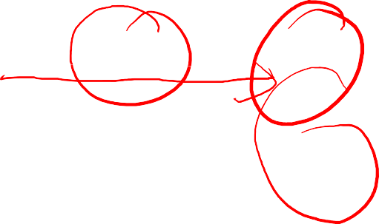
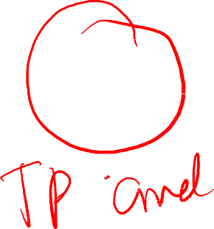


Confusion Matrix: Example
False Positives (FP): Number of outcomes that are actually negative
but predicted positive. These errors are also called Type 1 Errors.
For example: In diabetes(0) but diabetes(1).
this case, a the model
person actually doesn’t have
has
predicted that the person
False Negatives (FN): Number of outcomes that are actually positive but predicted negative. These errors are also called Type 2 Errors.
For example: In this case, a person actually has diabetes(1) but the model predicted that the person doesn’t have diabetes(0).
The represent the number of points for which the predicted label is
diagonal elements
equal to the true label, while are those that are
by
off-diagonal elements
mislabeled
the classifier.
The higher the diagonal values of the confusion matrix the better, indicating many correct predictions.

Slide 9






Four classification metrics from the Confusion Matrix
It can also be calculated in terms of positives and negatives for binary classification:
It doesn’t grant us much information regarding the distribution of false
positives and false negatives.
This metric is blind to the difference between classes and types of errors.
That’s why it is not good enough for imbalanced datasets.

Slide 10
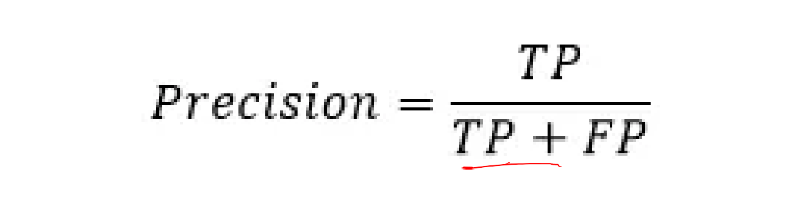
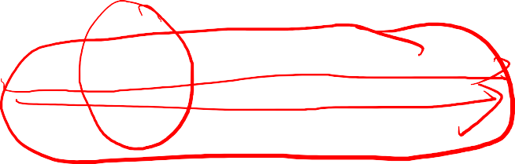


Precision
•
It is useful for the skewed and unbalanced dataset.
The more False positives the model predicts, the lower the precision
It is the ratio of True Positives to all the positives predicted by the model.
The precision considers when a sample is classified as Positive, but it does not care about correctly classifying all positive samples
10

Slide 11
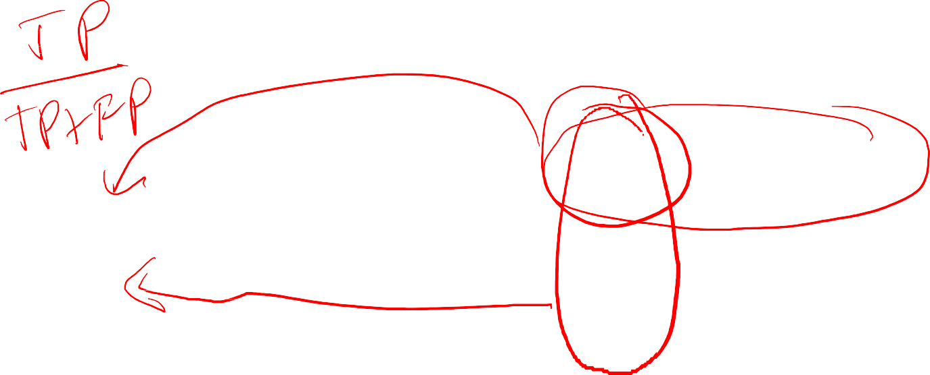






Recall
•
It is the ratio of true positives to all the positives in your dataset.
It measures the model’s ability to detect positive samples.
The more false negatives the model predicts, the lower the recall.
The recall cares about correctly classifying all positive samples, but it does not care if a negative sample is classified as positive.

Slide 12

F1-score or F-measure
It is a single metric that combines both Precision and Recall. The higher the F1 score, the better is the performance of our model. The range for F1-score is [0,1].
F1 score is the weighted average of precision and recall. The classifier will only get a high F-score if both precision and recall are high.
This metric only favours classifiers that have similar precision and recall.

Slide 13
Specificity and Sensitivity
Specificity: Specificity refers to the true negative rate
Specificity=TN/(TN+FP)
Sensitivity refers to the true positive rate
Sensitivity= TP/(TP+FN)
In summary, specificity focuses on correctly identifying negatives, while sensitivity focuses on correctly identifying positives. These two measures are often inversely related; increasing sensitivity may decrease specificity, and vice versa. The choice between high sensitivity or high specificity depends on the specific goals of the test and the consequences of false positives and false negatives.

Slide 14
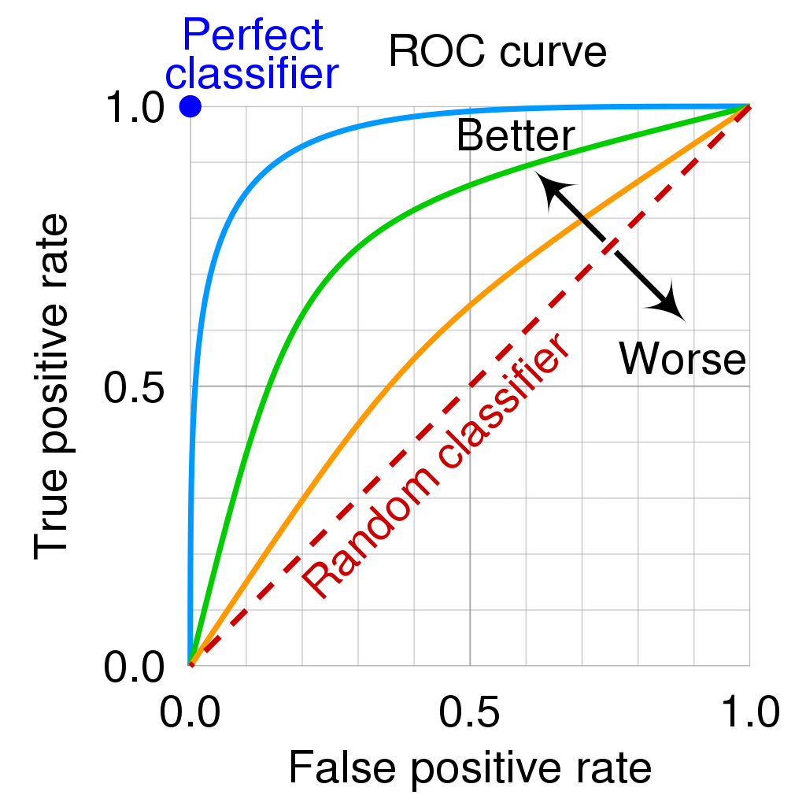
ROC Curve
Sensitivity(TPR) and Specificity(TNR) measures are used to plot the ROC curve.
They both have values in the range of [0,1] which are computed at varying threshold values.
Area under the ROC curve(AUC) is used to determine the model performance.

Slide 15

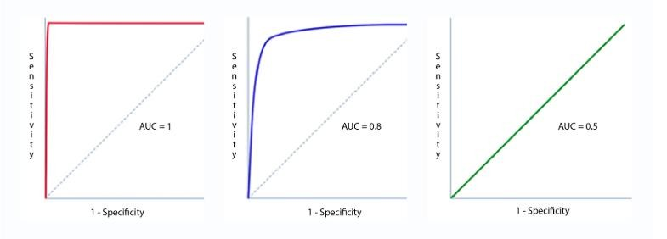





AUC (Area Under the Curve) or Area Under the ROC Curve
is a metric used to summarize a graph by using a single number. It is
AUC
used for binary classification problems.
AUC refers to the models capability to discriminate between positive and negative classes

Slide 16
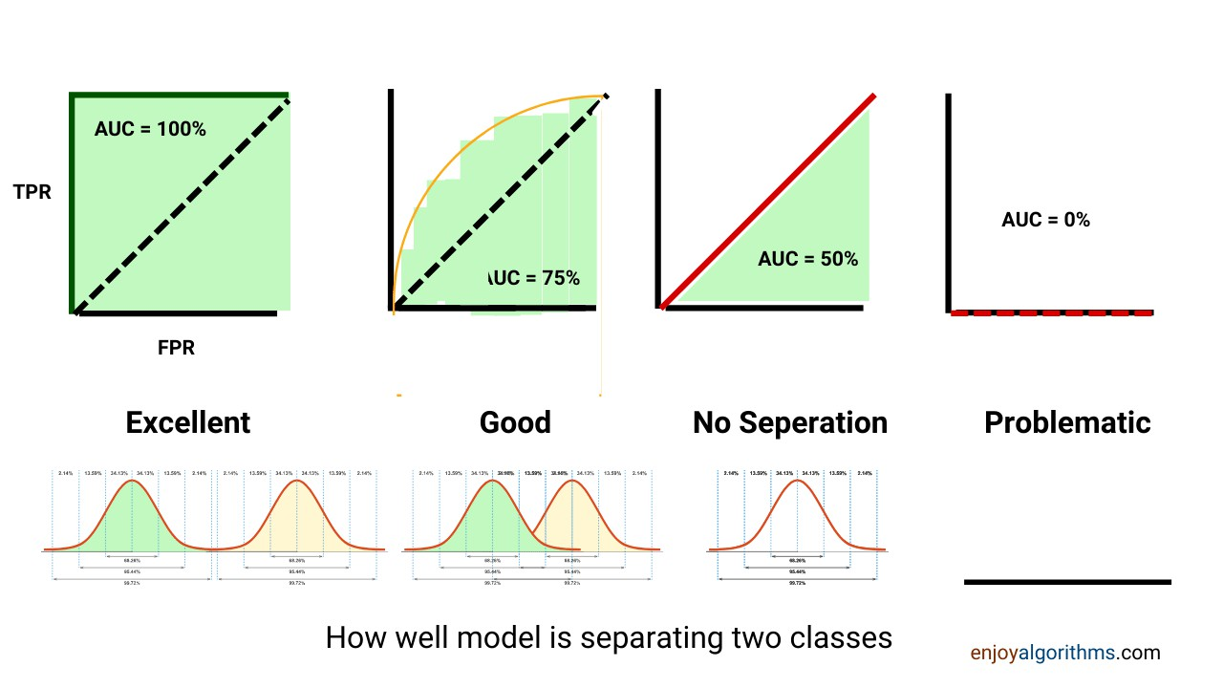

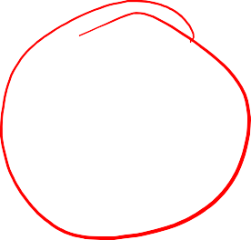


AUC (Area Under the Curve) or Area Under the ROC Curve

Slide 17
Thank you!!!

